Slide 1




Weekly report: Load & Dynamics
Week number: 10
Date: 02/12/2025
Supervisor: Mr. Manjock
Group members: Md Aman, Arham Memon, Paresh Nakum
Presenter – Md Aman
25/11/2025
Md Aman
Optimus Syria

Slide 2
Agenda For Loads & Dynamics
OpenFAST With LiDAR Simulation
All DLC Application & Simulation Updation
Conclusion & Future Plan
Bibliography
02/12/2025
Md Aman
Load & Dynamics Team/ Optimus Syria

Slide 3
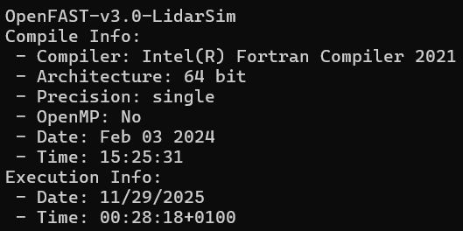
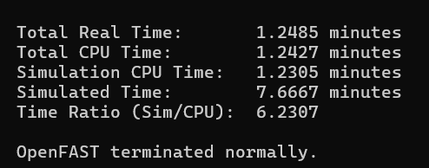
OpenFAST with LiDAR Simulation
LiDAR – Light Detection & Ranging
How LiDAR Works
1. Sends short laser pulses
2. Measures time for light to return
3. Calculates very accurate distance
4. Repeats measurements to detect motion
What it Generates
Scans many points in space
Builds detailed 3D maps of terrain
Creates 3D maps of the atmosphere
Provides vertical wind profiles (wind vs. height)
Lidar in OpenFAST: Preview wind for realistic loads, control design. Reduces rotor speed (40%), tower moments (17%), power variation (20%). Essential for turbine protection and it also accurate simulation.
Effect On Wind Turbine
Source: wes.copernicus.org LAC for wind turbines Feng Guo1, David Schlipf1, and Po Wen Cheng
02/12/2025
3
Md Aman
Load & Dynamics Team/ Optimus Syria

Slide 4
All DLC Updation
DLC | Condition | Wind Type
1.2 Power Production | Vin < Vhub < Vout | NTM
4.2 Normal Shut down | Vhub = Vr ± 2 m/s and Vout | EOG
5.1 Emergency Stop | Vhub = Vr ± 2 m/s and Vout | NTM
6.1 Parked & Idling | Vhub = Vref | EWM
7.1 Parked + Fault | Vhub = V1 | EWM
The Final DLC for our Optimus Syria 5 MW project.
Calculation Updated with LiDAR Simulation. Calculation are also update with including safety factor.
02/12/2025
4
Md Aman
Load & Dynamics Team/ Optimus Syria

Slide 5
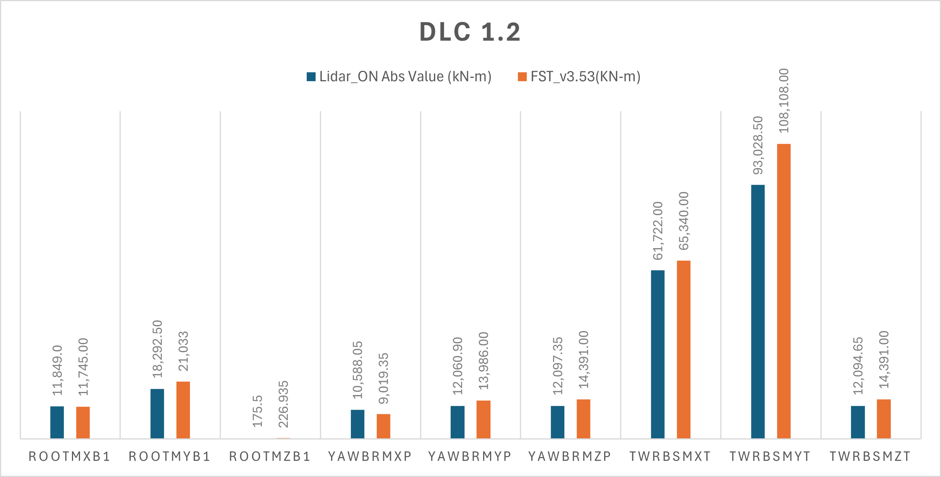
Simulation Update – DLC 1.2 Normal Operation
Including Safety Factors For Lidar On simulation, Wind Speed @ 25ms, wind Type NTM
02/12/2025
5
Md Aman
Load & Dynamics Team/ Optimus Syria

Slide 6
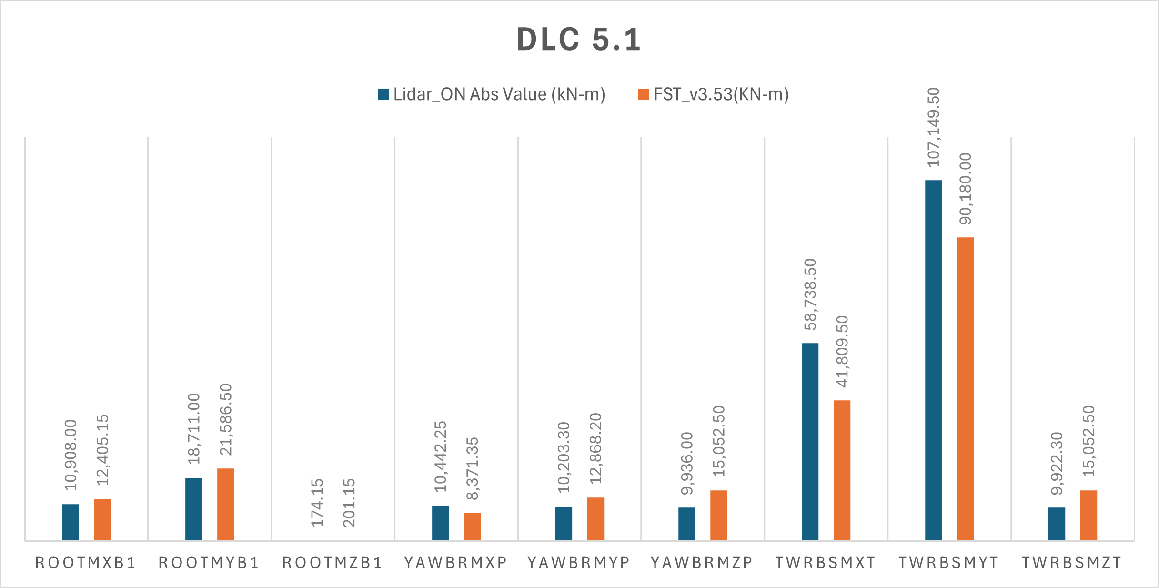
Simulation Update – DLC 5.1 Emergency Stop
Including Safety Factors For Lidar On simulation, Wind Speed @ 25ms, wind Type NTM
02/12/2025
6
Md Aman
Load & Dynamics Team/ Optimus Syria

Slide 7
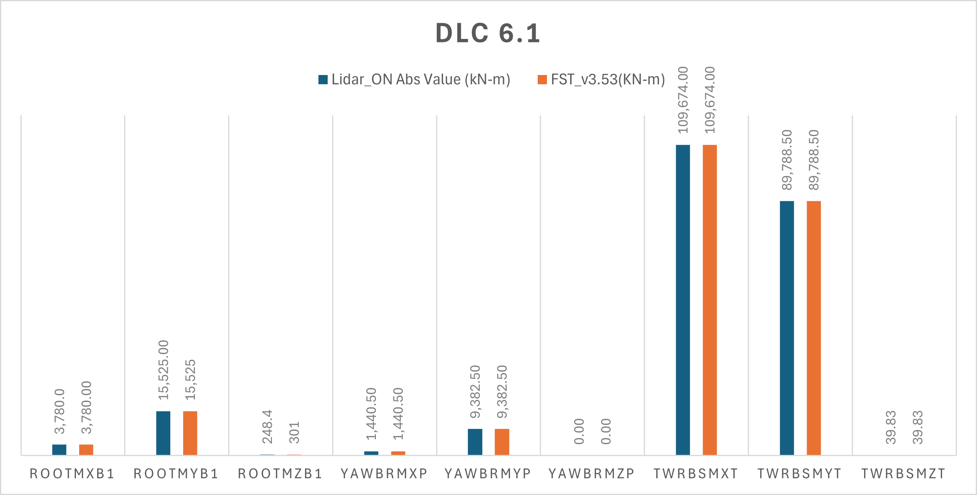
Simulation Update- DLC 6.1 Parked
Including Safety Factors For Lidar On simulation, Wind Speed @ 42.5ms, wind Type EWM for 50 yr period
02/12/2025
7
Md Aman
Load & Dynamics Team/ Optimus Syria

Slide 8
Conclusion & Future Plan
In the last week we
Did not received OPTIMUS Syria Blade Data from Blade Team
Updated previous DLC Simulations with Lidar Controller from Control Team
Installed Mextremes Performed Basic tests
Provided forces and moments at different section of turbine to other teams
In the next week
Work with tower groups for generating twr.dat files
Update OpenFAST for DLC 4.2 (EOG) & DLC 7.1(Parked+Fault)
Start Calculation of MExtremes
02/12/2025
8
Md Aman
Load & Dynamics Team/ Optimus Syria

Slide 9
References
Load Reports of the OPTIMUS projects
GL Guideline for the Certification of Wind Turbines Edition 2010
Standard, DNVGL-ST-0376 – Edition December 2015
IEC 61400-1 2019-02, Ed. 4.0/ DNVGL-ST-0437 Loads and site conditions for wind turbines 11-2016
TurbSim, OpenFAST_v3.0 & NREL 5 MW
wes.copernicus.org LAC for wind turbines Feng Guo1, David Schlipf1, and Po Wen Cheng
02/12/2025
9
Md Aman
Load & Dynamics Team/ Optimus Syria

